Slide 1
QUIZ COMPETITION

Slide 2
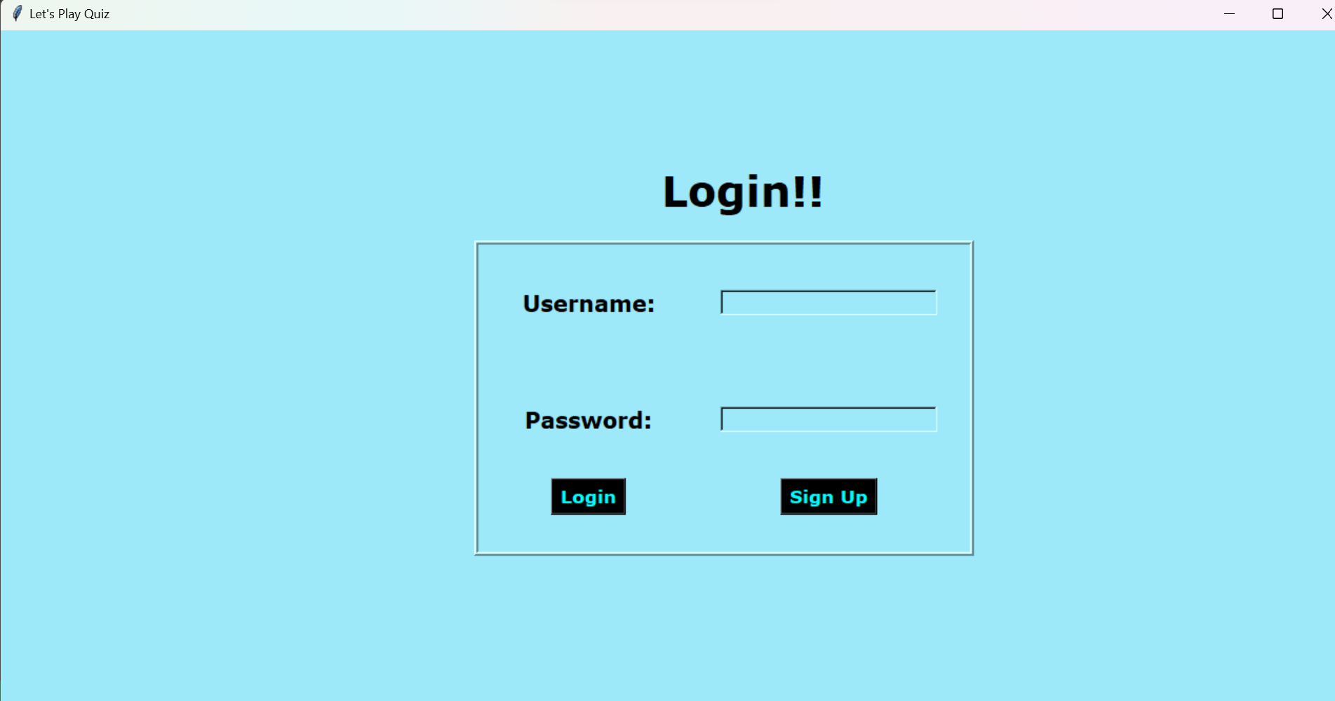
LOGIN PAGE OF THE QUIZ COMPETITION

Slide 3
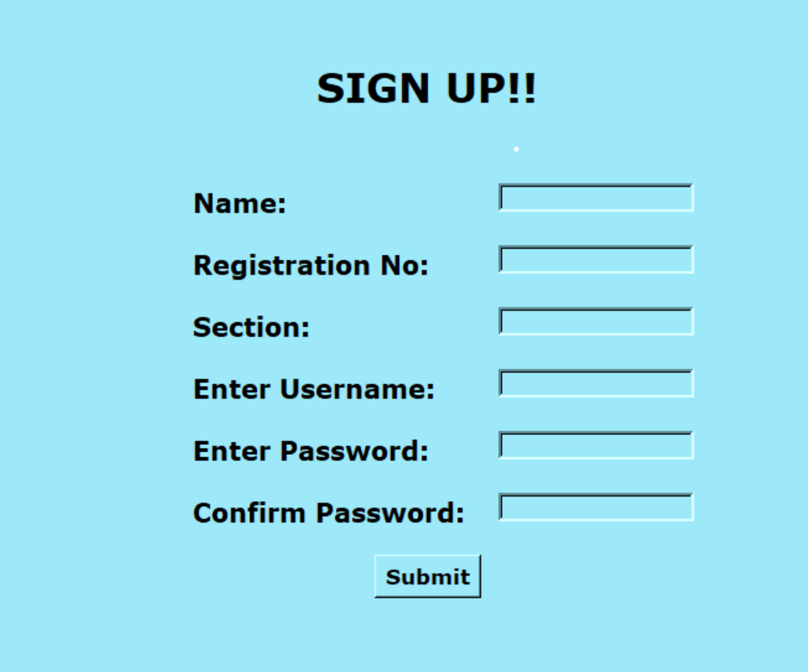
SIGN UP PAGE

Slide 4
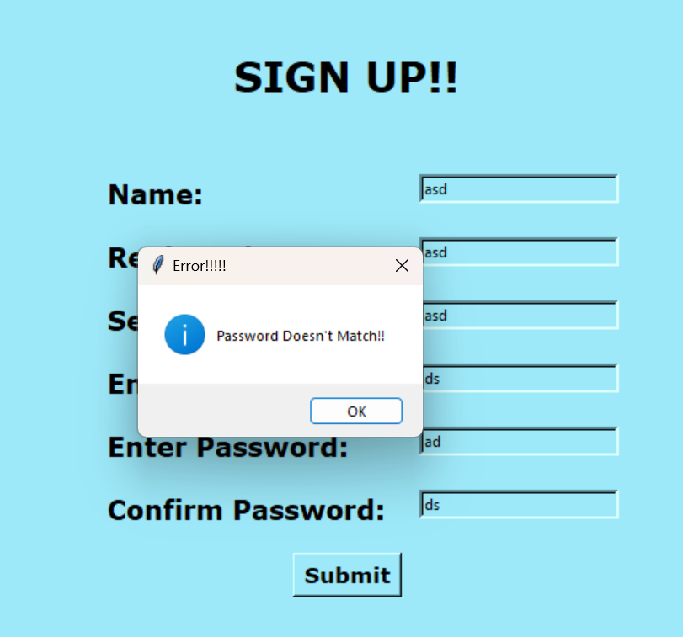
IT SHOWS ERROR MESSAGE WHENEVER INPUT PASSWORDS DO NOT MATCH

Slide 5
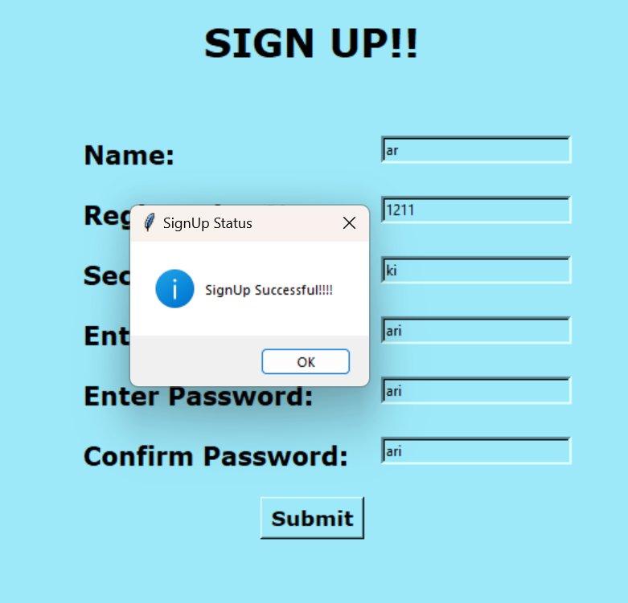
AFTER SUCESSFULLY SIGN UP , A MESSAGE POP UPS SIGN UP SUCESSFULLY

Slide 6
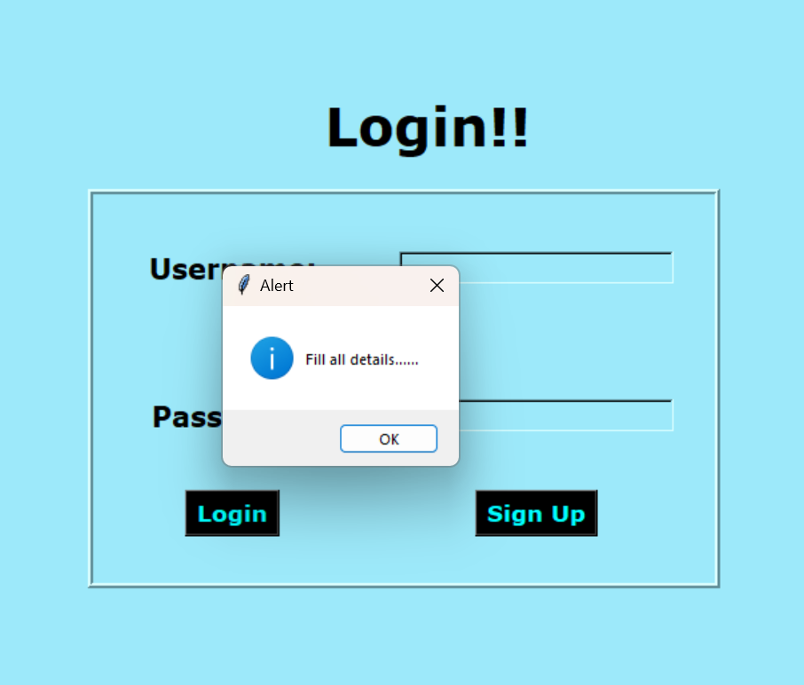
Error message if we TRY TO LOGIN WITHOUT FILLING USERNAME OR PASSWORD

Slide 7
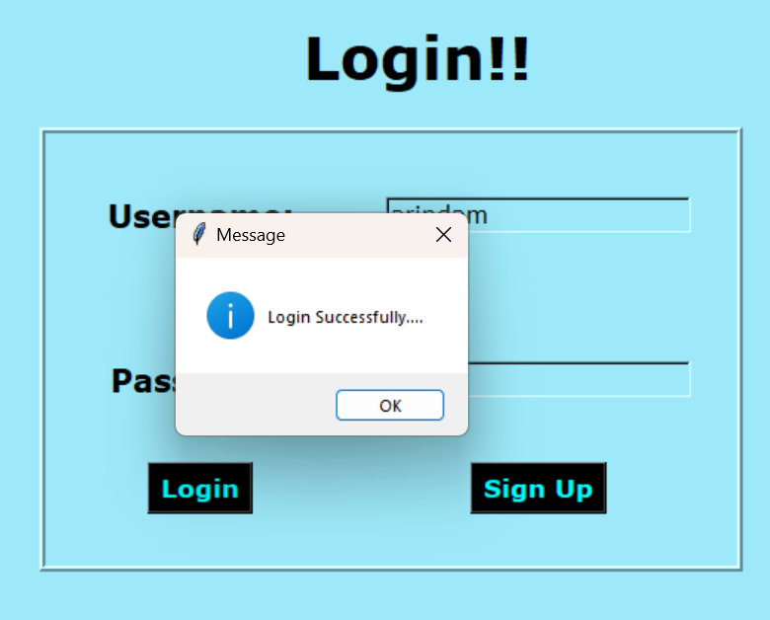
LOGIN SUCESSFUL MESSAGE

Slide 8

WELCOME PAGE

Slide 9
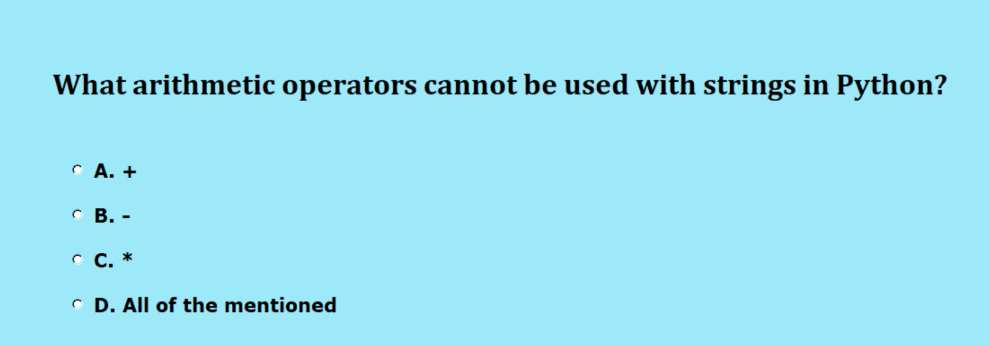
Sample question of the quiz

Slide 10
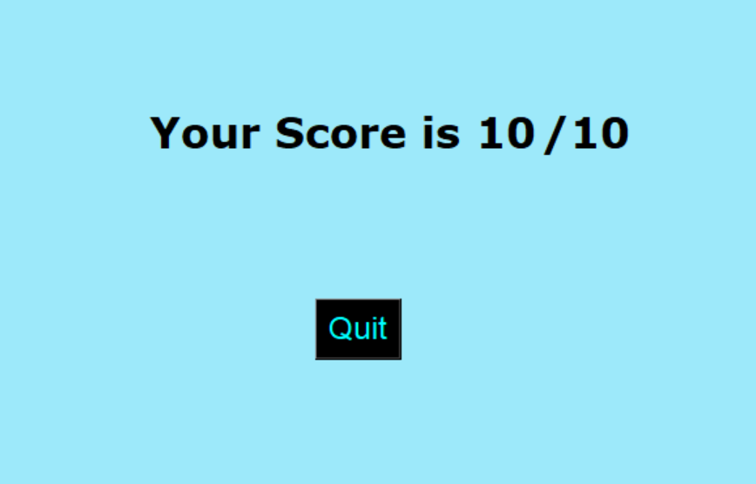
Result of the quiz

Slide 11
THANK YOU

